Slide 1
Mobile App for Direct Market Access for Farmers
CSE7301- University Project
Final Viva-Voce
Batch Number: CSE-G97
Under the Supervision of,
Dr. N Thirmoorthy Assistant Professor(CS&IS)
School of Computer Science and Engineering
Presidency University
Name of the Program: B Tech
Name of the HoD: Asif Mohammed HB
Name of the Program Project Coordinator: Mr. Jerrin Joe Francis
Name of the School Project Coordinators: Dr. Sampath A K / Mr. Md Ziaur Rahman
Roll Number | Student Name
20211CSE0137 | R Karthik
20211CSE0138 | B Madhusudhan
20211CSE0189 20211CSE0048 | Y Sai Uday Kiran Reddy Jatin Thapa

Slide 2
Abstract
Small-scale farmers often face challenges in accessing direct markets, leading to dependency on middlemen,
reduced profits, and market inefficiencies. This project proposes the development of a mobile application that connects farmers directly with consumers, ensuring fair pricing, transparency, and direct communication. The app features a Farmer
Module, where farmers can register, list their produce with price per kilogram, view past transactions, and analyse market trends. It also includes a Consumer Module, enabling consumers to register, browse available produce, track purchase history, and negotiate prices through a comment-based system. By facilitating direct farmer-to-consumer interactions, this solution eliminates intermediaries, enhances market efficiency, and empowers farmers with better pricing control. Additionally, the built-in market analysis feature helps farmers make informed decisions, ensuring sustainability and profitability. This mobile application aims to revolutionize agricultural trade by fostering a transparent, competitive, and farmer-centric marketplace, ultimately benefiting both farmers and consumers.

Slide 3





Literature Survey
Background
Farmers struggle to access markets and get fair prices due to intermediaries.
Existing platforms (eNAM, Agmarknet) provide price data but lack direct farmer-to-consumer transactions.
Many farmers have limited digital literacy, making complex platforms difficult to use.
Key Findings & Gaps
Market price data is available, but farmers cannot negotiate directly. Existing platforms are not user-friendly for rural farmers.
No seamless transaction & payment integration in current solutions
How Our Project Solves These Gaps
Direct farmer-to-consumer sales without middlemen.
User-friendly mobile app with local language support.
Real-time price tracking & negotiation to empower farmers.
Integrated payments (UPI) for secure transactions.

Slide 4
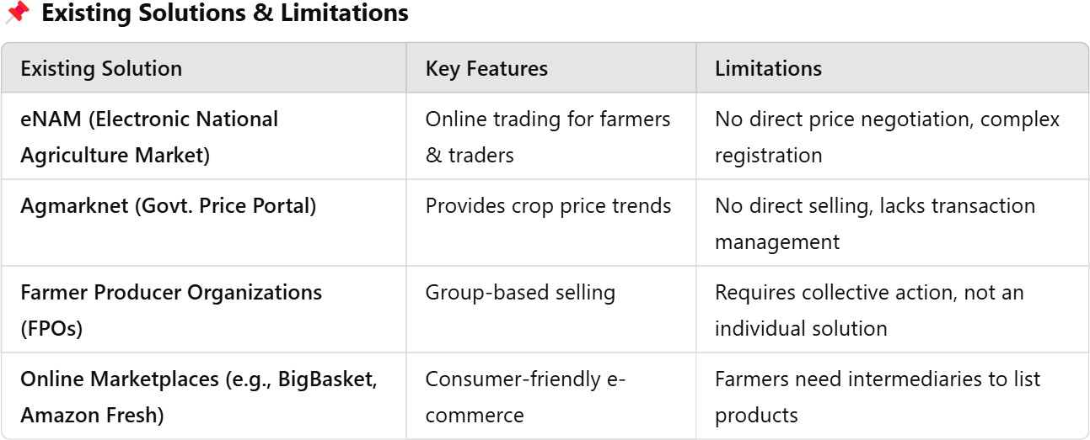
Literature Survey

Slide 5



Objectives
Finalized Objectives Project Goal:
"To develop a mobile application that enables farmers to sell
directly to consumers, ensuring fair pricing and reducing
dependency on middlemen.“
Key Objectives:
Build an easy-to-use Android app for farmers and buyers.
Implement direct selling & price negotiation features.
Integrate real-time market prices & analytics.
Enable secure online payments (UPI).
Provide language support for better adoption in rural areas.

Slide 6
Existing methods - Drawbacks
Farmers sell produce through middlemen or local markets. Consumers purchase from retailers or wholesalers.
Price negotiation is indirect and controlled by intermediaries.
Drawbacks:
Limited Market Access: Farmers rely on middlemen, reducing profit
margins.
Lack of Transparency: Price fluctuations and unfair pricing due to multiple intermediaries.
Inefficiency: Delays in selling produce, leading to potential wastage. No Direct Communication: Farmers and consumers cannot negotiate prices directly.
Lack of Market Insights: Farmers have no access to demand trends or real-time price data.

Slide 7
Proposed Methods
Solution: Direct Market Access App for Farmers & Consumers
Key Features:
Farmer Dashboard: List and manage produce, track past sales, and access market analysis.
Consumer Dashboard: Browse farmer-listed produce, view purchase history, and negotiate prices.
Real-time Negotiation: Comment-based price discussions between farmers and consumers. Market Analysis: Provide farmers with insights on demand, pricing trends, and competitor analysis. Transparent & Efficient Transactions: Direct interaction ensures fair pricing and faster deals.
This solution empowers both farmers and consumers, eliminating middlemen and ensuring a more efficient
agricultural marketplace.

Slide 8
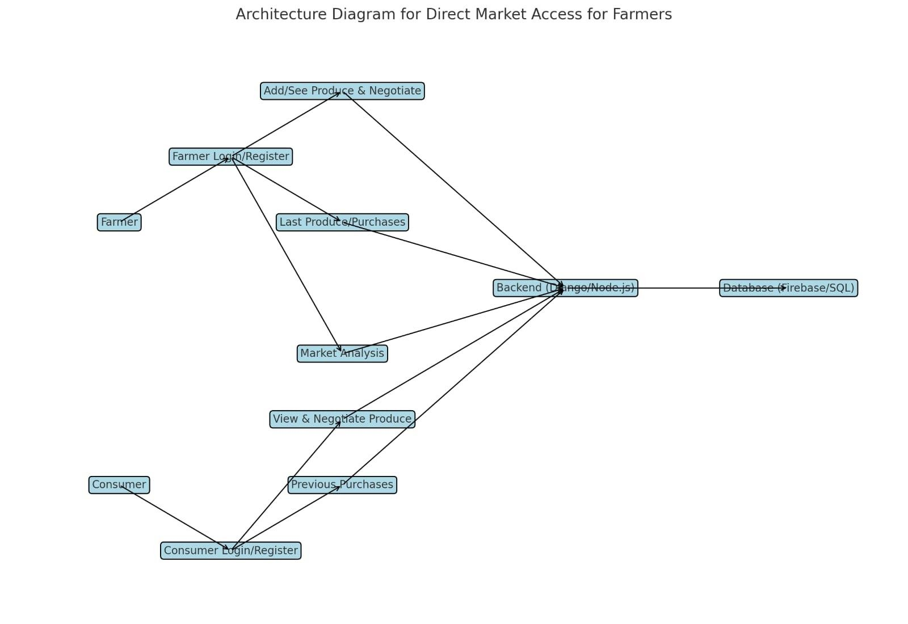
Architecture Diagram

Slide 9
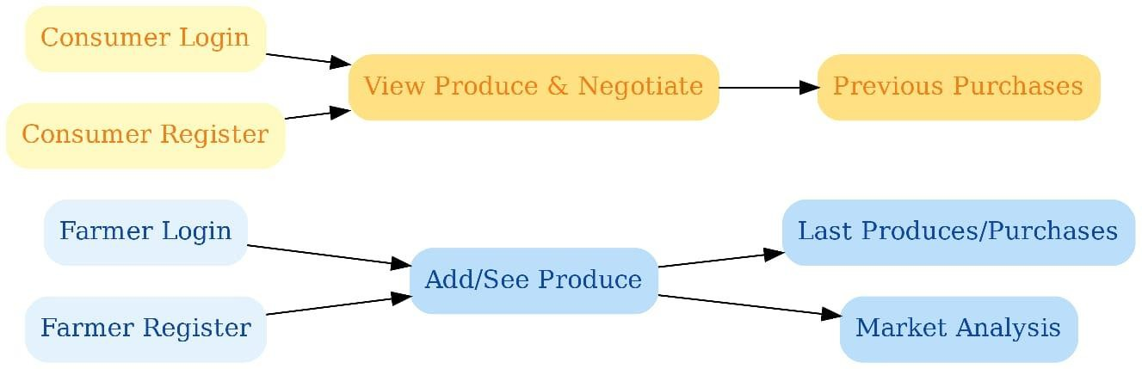
Architecture Diagram

Slide 10
Modules
User Authentication Module
Farmer & Consumer Registration/Login.
Secure authentication & user management.
Farmer Dashboard
Add & manage produce listings.
Set prices per kg & update availability.
View past sales & purchases.
Market analysis insights.
Consumer Dashboard
Browse available produce with pricing.
View purchase history.
Comment-based negotiation system.

Slide 11
Modules
Market Analysis Module
Real-time price trends for specific crops. Demand and supply analytics.
Transaction & Order Management Track purchases & sales.
Payment integration.
Notification & Communication Module
Alerts for price negotiations, new listings, and purchases.
Chat or comment system for buyer-seller interaction.

Slide 12
Hardware And Software Components
Software Requirements:
Operating System:
Windows 10/11, macOS, or Linux (for development) Android (for mobile application deployment) Development Environment:
Android Studio – For mobile app development
Visual Studio Code / PyCharm – For backend & API development
Programming Languages:
Java / Kotlin – For Android app development
Python (Django) / JavaScript (Node.js) – For backend services
Database & Storage:
Firebase Realtime Database / Firestore – Cloud-based NoSQL database
MySQL / PostgreSQL – If using a relational database
Cloud Storage (Firebase / AWS S3) – For image & document storage
APIs & Services:
Google Maps API – Location-based services
Government Market Price APIs – For fetching live crop prices
Payment Gateway (Razorpay / Stripe / UPI) – For secure transactions
Other Tools:
GitHub / GitLab – Version control and collaboration
Postman – API testing
Firebase Authentication – User authentication & management

Slide 13
Hardware And Software Components
Hardware Requirements:
Development Environment:
For Development: Laptop/Desktop:
Processor: Intel i5/i7 or AMD Ryzen 5/7 (or higher)
RAM: 8GB minimum (16GB recommended)
Storage: 256GB SSD (512GB+ preferred)
GPU: Integrated or dedicated GPU (if needed for graphics processing)
OS: Windows 10/11, macOS, or Linux For Hosting & Server (if applicable):
Cloud Server (AWS / Google Cloud / Firebase / DigitalOcean)
CPU: 2+ vCPUs
RAM: 4GB+
Storage: 50GB SSD+ (depending on data usage)
For End Users (Farmers & Consumers):
Android Smartphone:
OS: Android 7.0 (Nougat) or above
RAM: 2GB+
Storage: Minimum 16GB
Internet: 4G/5G connectivity recommended
Other Essential Hardware:
Internet Connection: Stable broadband or mobile data Smartphone or Tablet (for Testing & User Accessibility) Power Backup (UPS/Inverter) for uninterrupted development

Slide 14
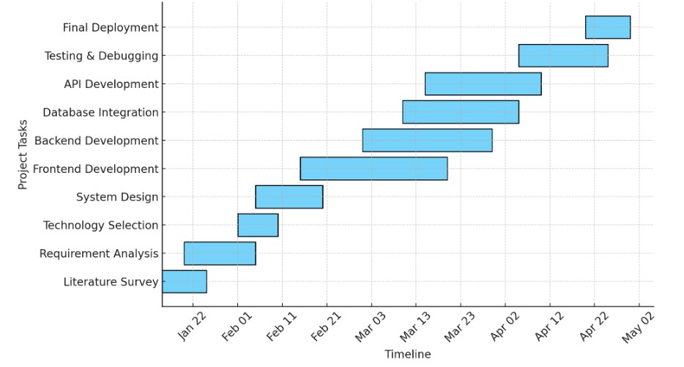
Timeline of the Project (Gantt Chart)

Slide 15
GITHUB LINK:
https://github.com/Karthikroyal76/final-year-project

Slide 16
References (IEEE Paper format)
A. S. Patil and S. S. Patil, "Digital Market: E-Commerce Application For Farmers," 2019 3rd International Conference on Computing Methodologies and Communication (ICCMC), Erode, India, 2019, pp. 1004-1007. DOI: 10.1109/ICCMC.2019.8819780
S. S. Patil, S. S. Patil, and S. S. Patil, "Android App to Connect Farmers to Retailers and Food Processing Units," 2019 International Conference on Smart Systems and Inventive Technology (ICSSIT), Tirunelveli, India, 2019, pp. 1080-1083. DOI: 10.1109/ICSSIT46314.2019.8987930
M. S. Hossain, M. N. Islam, and M. S. Islam, "Implementing E-Commerce Mobile and Web Application for Agricultural Products: e-Farmers' Hut," 2022 International Conference on Innovations in Science, Engineering and Technology (ICISET), Chittagong, Bangladesh, 2022, pp. 1-6. DOI: 10.1109/ICISET54412.2022.9776930
S. S. Patil and S. S. Patil, "Agriculture marketing using web and mobile based technologies," 2016 International Conference on Computing Communication Control and automation (ICCUBEA), Pune, India, 2016, pp. 1-4. DOI: 10.1109/ICCUBEA.2016.7801211
A. S. Patil and S. S. Patil, "Farm Book: An Interactive Mobile Application for Smart Farming," 2023 International Conference on Smart Technologies in Computing, Electrical and Electronics (ICSTCEE), Bengaluru, India, 2023, pp. 1-5. DOI: 10.1109/ICSTCEE57404.2023.10134494

Slide 17


